Slide 1
BITS Pilani
Dr. Lavika Goel
Assistant Professor
Department of CSIS
Lecture 10: 7/4/2019
Pilani Campus

Slide 2
Pilani Campus
Multimedia Information Retrieval

Slide 3
Today’s Agenda
Multimedia data
Multimedia retrieval
Multimedia search examples
Applications
Metadata Driven Retrieval
Piggy-back retrieval
4/6/2019 SS ZG537 (INFORMATION RETRIEVAL) 3
Pilani Campus

Slide 4
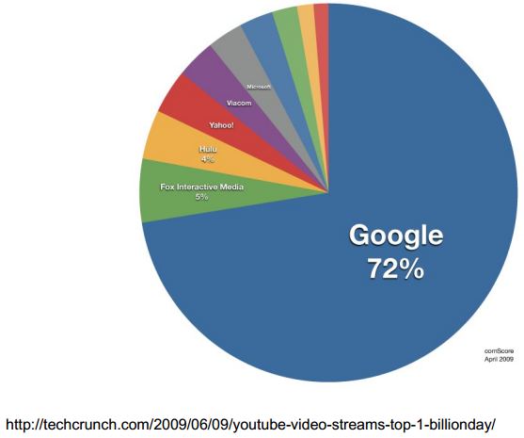
Percentage of total US Video streams
4/6/2019 SS ZG537 (INFORMATION RETRIEVAL) 4
Pilani Campus

Slide 5
Multimedia data
Internet traffic
predominantly video (by volume)
YouTube
24h video uploaded / minute
Flickr
5000 images uploaded per minute
iTunes
>10 billion songs downloaded
Amazon
>650000 books offered, millions of Kindles sold
more e-books than hardcover sales
4/6/2019 SS ZG537 (INFORMATION RETRIEVAL) 5
Pilani Campus

Slide 6
Multimedia retrieval
sample tasks
find copies and recordings of music/video
find all images/videos containing a person
find audio/video containing a spoken keyword
find music in a similar style
find all books/newspaper articles mentioning a keyword
sample applications
personal media management (duplicate removal, snapshots, …)
Forensic applications (illegal copies, pornography, evidence, …)
social science research (finding people, objects, ...)
4/6/2019 SS ZG537 (INFORMATION RETRIEVAL) 6
Pilani Campus

Slide 7
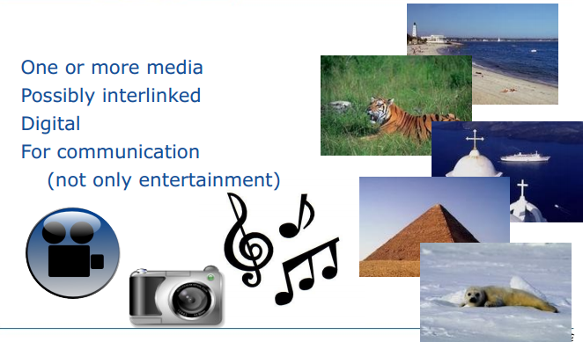
What is Multimedia?
4/6/2019 SS ZG537 (INFORMATION RETRIEVAL) 7
Pilani Campus
Notes:
Analyse, store and retrieve information

Slide 8
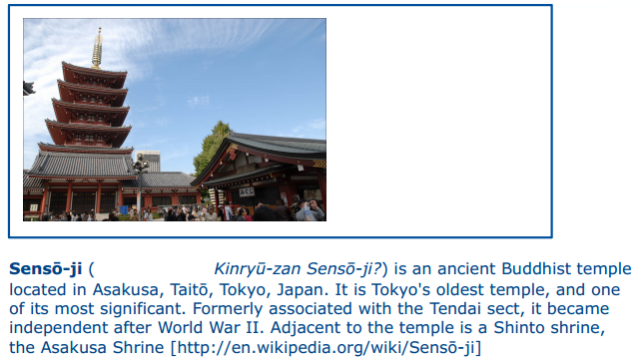
Multimedia queries
4/6/2019 SS ZG537 (INFORMATION RETRIEVAL) 8
Pilani Campus
Notes:
Take a pic of this building and send it to a service that can tell me information about the building

Slide 9

Web based image search
bits pilani hyderabad auditorium
4/6/2019 SS ZG537 (INFORMATION RETRIEVAL) 9
Pilani Campus

Slide 10
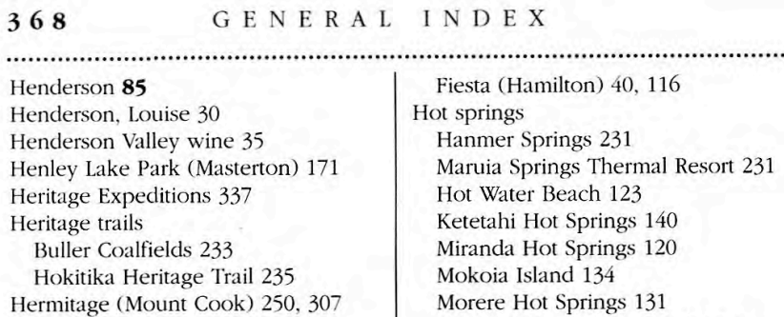
Web based image search
Best current practice is text search
Find text in filename, anchor text, Caption,…
Text search work by creating an index.
4/6/2019 SS ZG537 (INFORMATION RETRIEVAL) 10
Pilani Campus

Slide 11
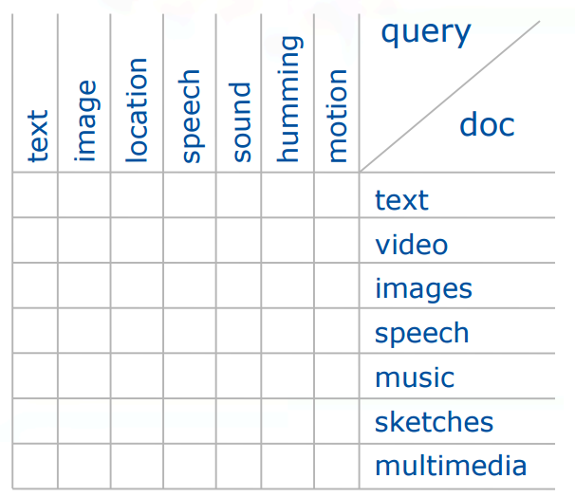
New search types
Conventional text retrieval
Type “terror attacks” and
get all CCNIBN news
Hum a music piece and
get all similar music
Roar like a Lion and get
a wild life documentary
4/6/2019 SS ZG537 (INFORMATION RETRIEVAL) 11
Pilani Campus

Slide 12
Challenges in MMIR
Semantic Gap
Ploysemy
Fusion Problem: how to combine possibly conflicting evidence of two images similarity?
Responsiveness: Naïve comparison of query feature vectors to the database feature vectors requires linear scan through the database.
4/6/2019 SS ZG537 (INFORMATION RETRIEVAL) 12
Pilani Campus

Slide 13
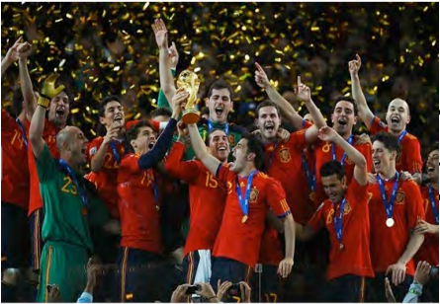
The Semantic gap
Pixels with spatial distribution
Faces and vase like object
4/6/2019 SS ZG537 (INFORMATION RETRIEVAL) 13
Pilani Campus

Slide 14
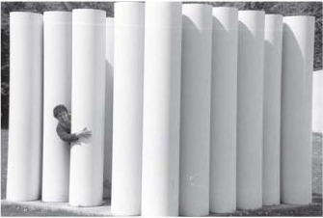
Polysemy
4/6/2019 SS ZG537 (INFORMATION RETRIEVAL) 14
Pilani Campus

Slide 15
Basic Multimedia search technologies
Metadata are pieces of information about a multimedia object that are not strictly necessary for working with it, but that are useful to
describe resources so they can be indexed, classified, located, browsed and found
store technical information, such as data formats and compression schemes
manage resources such as their rights or where they are currently located
record preservation actions
create usage trails, eg, which section of a video has been watched how many times
4/6/2019 SS ZG537 (INFORMATION RETRIEVAL) 15
Pilani Campus

Slide 16
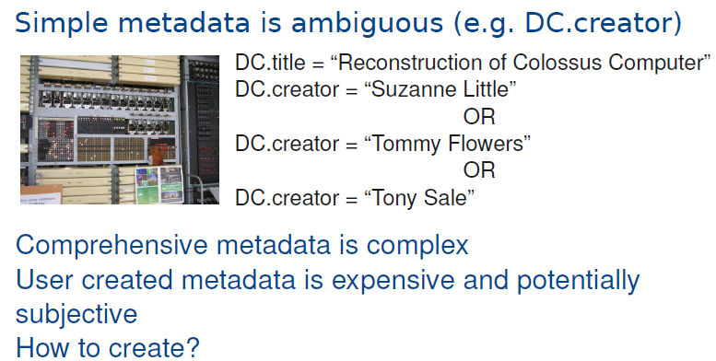
Why Metadata is difficult?
4/6/2019 SS ZG537 (INFORMATION RETRIEVAL) 16
Pilani Campus

Slide 17
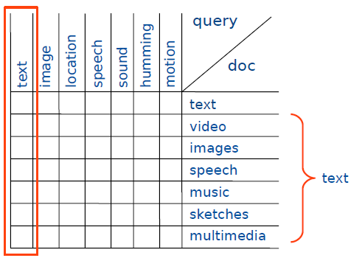
Piggy-back retrieval
4/6/2019 SS ZG537 (INFORMATION RETRIEVAL) 17
Pilani Campus
Notes:
Piggy-back text retrieval is retrieval of multimedia documents by text.
When you have text descriptions of multimedia objects we can use this text for retrieval. (Image search based on image description)

Slide 18
Why content-based?
Give examples where we remember details by
metadata?
context?
content (eg, “x” belongs to “y”)?
Metadata versus content-based: pro and con
4/6/2019 SS ZG537 (INFORMATION RETRIEVAL) 18
Pilani Campus

Slide 19
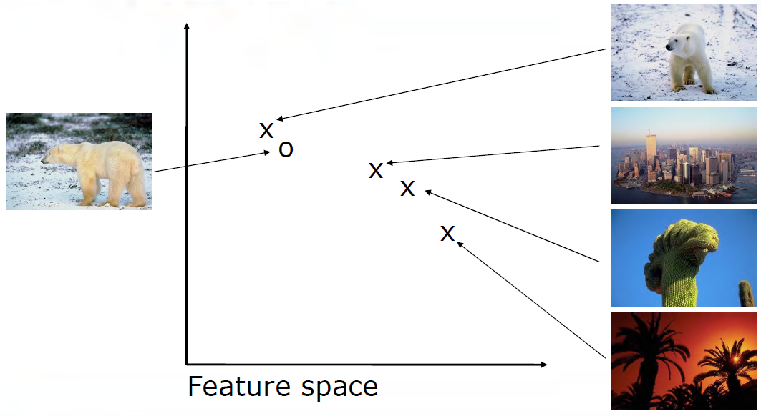
Content-based retrieval:
features and distances
4/6/2019 SS ZG537 (INFORMATION RETRIEVAL) 19
Pilani Campus

Slide 20
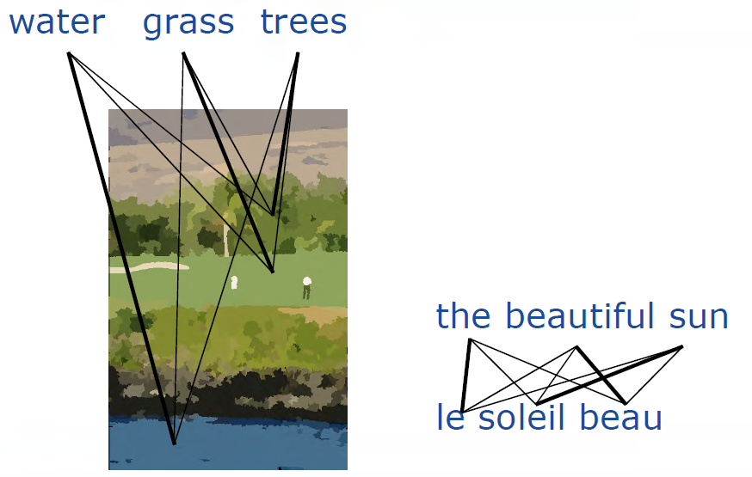
Automated annotation as
machine translation
4/6/2019 SS ZG537 (INFORMATION RETRIEVAL) 20
Pilani Campus

Slide 21
Automated annotation as
machine learning
Probabilistic models:
maximum entropy models
models for joint and conditional probabilities
evidence combination with Support Vector Machines
[with Magalhães, SIGIR 2005]
[with Yavlinsky and Schofield, CIVR 2005]
[with Yavlinsky, Heesch and Pickering: ICASSP May 2004]
[with Yavlinsky et al CIVR 2005]
[with Yavlinsky SPIE 2007]
[with Magalhães CIVR 2007, best paper]
4/6/2019 SS ZG537 (INFORMATION RETRIEVAL) 21
Pilani Campus

Slide 22
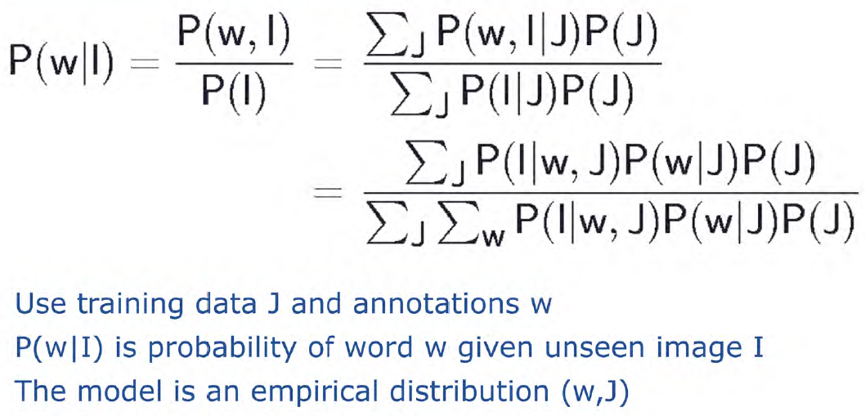
A simple Bayesian classifier
4/6/2019 SS ZG537 (INFORMATION RETRIEVAL) 22
Pilani Campus

Slide 23
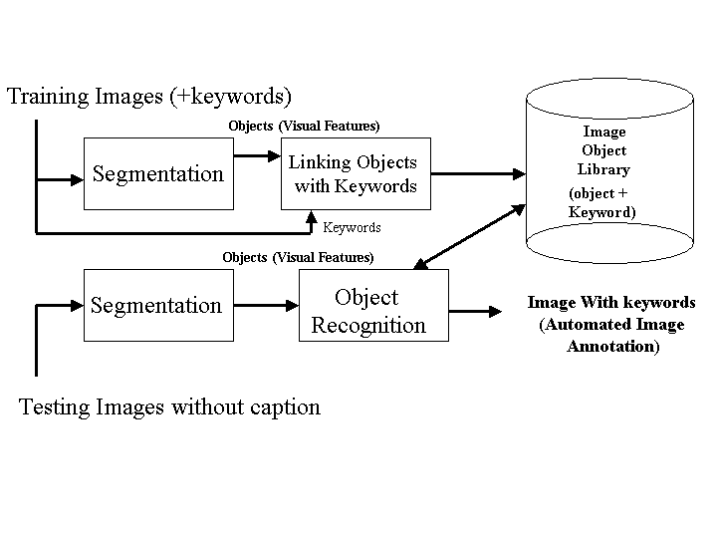
Annotation
4/6/2019 SS ZG537 (INFORMATION RETRIEVAL) 23
Pilani Campus
Notes:
Automated image annotation is a machine translation problem
Segment pictures into block of shapes of similar color/texture and correlate with words.
Describe objects in terms of appearences

Slide 24
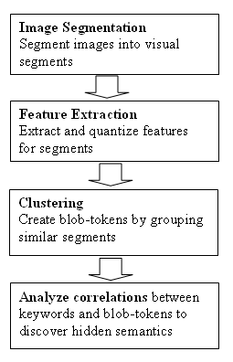
Annotation
Major steps:
Segmentation into regions
Clustering to construct blob-tokens
Analyze correspondence between key words and blob-tokens
Auto Annotation
4/6/2019 SS ZG537 (INFORMATION RETRIEVAL) 24
Pilani Campus

Slide 25
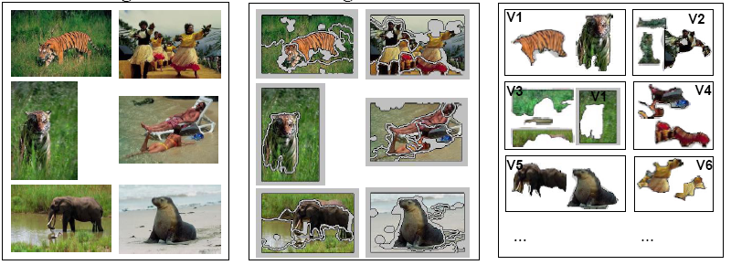
Annotation: Segmentation & Clustering
Images Segments Blob-tokens
4/6/2019 SS ZG537 (INFORMATION RETRIEVAL) 25
Pilani Campus

Slide 26
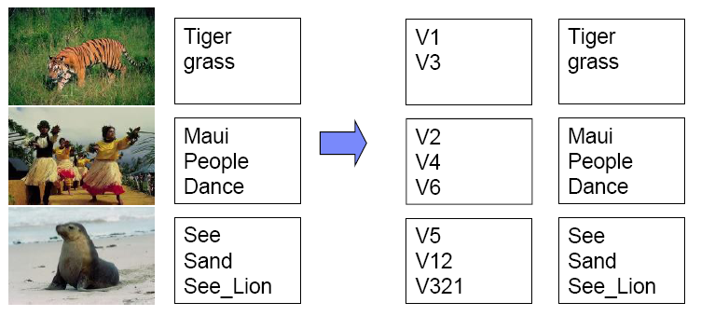
Annotation: Correspondence/Linking
Our purpose is to find correspondence between words and blob-tokens.
P(Tiger|V1), P(V2|grass)…
4/6/2019 SS ZG537 (INFORMATION RETRIEVAL) 26
Pilani Campus

Slide 27
Feature Extraction & Clustering
Feature Extraction:
Color
Texture
Shape
K-means clustering: To generate finite visual terms. Each cluster’s centroid represents a visual term.
4/6/2019 SS ZG537 (INFORMATION RETRIEVAL) 27
Pilani Campus

Slide 28
Co-Occurrence Models
 | w1 | w2 | w3 | w4
V1 | 12 | 2 | 0 | 1
V2 | 32 | 40 | 13 | 32
V3 | 13 | 12 | 0 | 0
V4 | 65 | 43 | 12 | 0
Mori et al. 1999
Create the co-occurrence table using a training set of annotated images
Tend to annotate with high frequency words
Context is ignored
Needs joint probability models
P( w1 | v1 ) = 12/(12+2+0+1)=0.8
P( v3 | w2 ) = 12/(2+40+12+43)=0.12
4/6/2019 SS ZG537 (INFORMATION RETRIEVAL) 28
Pilani Campus

Slide 29
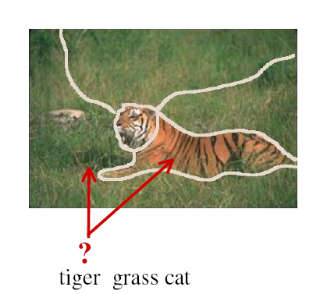

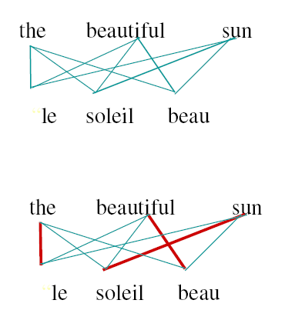
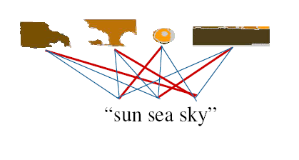
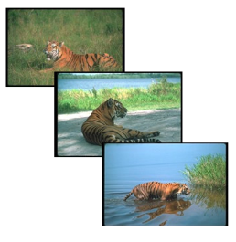
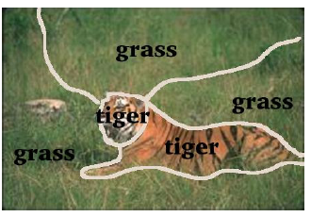
Correspondence: Translation Model (TM)
Pr(f|e) = ∑ Pr(f,a|e)
Pr(w|v) = ∑ Pr(w,a|v)
4/6/2019 SS ZG537 (INFORMATION RETRIEVAL) 29
Pilani Campus

Slide 30
Translation Models
Duygulu et al. 2002
Use classical IBM machine translation models to translate visterms into words
IBM machine translation models
Need a bi-lingual corpus to train the models
Mary did not slap the green witch
Mary no daba una botefada a la bruja verde
V2 V4 V6
Maui People Dance
V1 V34 V321 V21
Tiger grass sky
…
…
…
…
…
…
4/6/2019 SS ZG537 (INFORMATION RETRIEVAL) 30
Pilani Campus

Slide 31
Image Descriptions
Subjective interpretation of content: means different things to different people
Different features for different applications
Colour is important of out-door image but not for X-rays, CT, MRI etc.
Motion features are sometimes important (ultrasound)
Different systems for different applications
4/6/2019 SS ZG537 (INFORMATION RETRIEVAL) 31
Pilani Campus

Slide 32

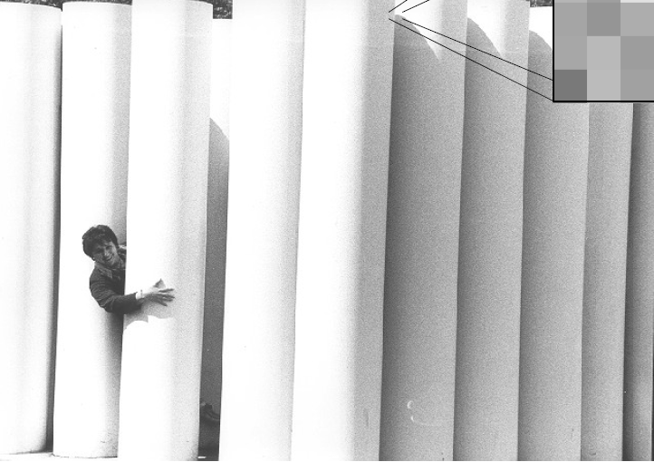
Digital Images
4/6/2019 SS ZG537 (INFORMATION RETRIEVAL) 32
Pilani Campus

Slide 33

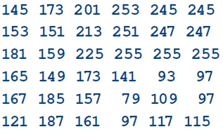
Digital Images
4/6/2019 SS ZG537 (INFORMATION RETRIEVAL) 33
Pilani Campus

Slide 34
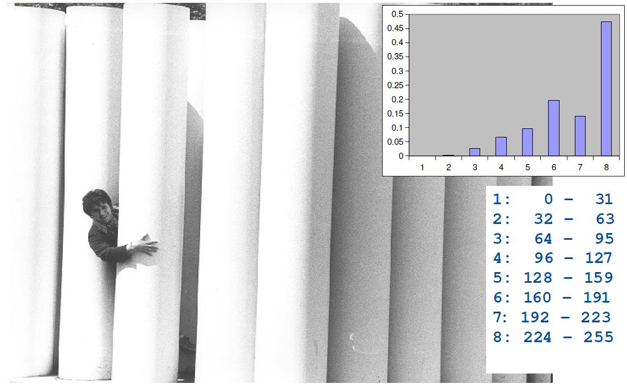
Histogram
4/6/2019 SS ZG537 (INFORMATION RETRIEVAL) 34
Pilani Campus

Slide 35
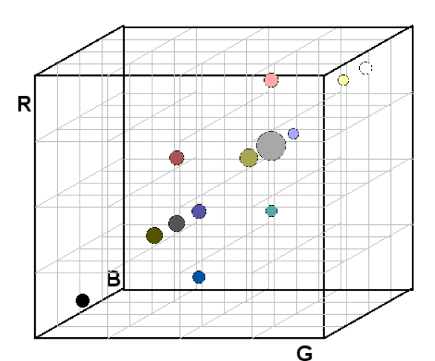
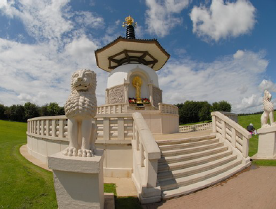
Colour histogram
4/6/2019 SS ZG537 (INFORMATION RETRIEVAL) 35
Pilani Campus
Notes:
Count how many pixels will fall into which area of the color cube

Slide 36

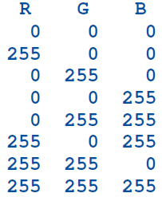

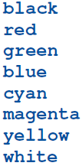
Exercise
4/6/2019 SS ZG537 (INFORMATION RETRIEVAL) 36
Pilani Campus

Slide 37
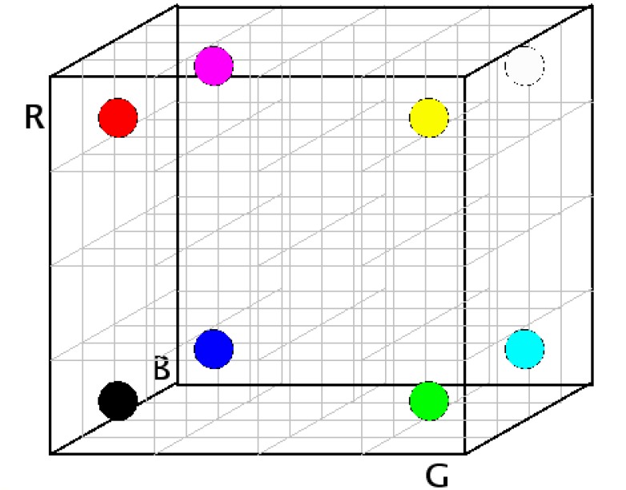
Solution
4/6/2019 SS ZG537 (INFORMATION RETRIEVAL) 37
Pilani Campus
Notes:
The 3D histogram is more informative because we can always create 3 one dimensional histogram by projecting the information form the joint distribution to the individual marginal distribution but you cannot do the other way round.
Whenever we marginalize the distributions we loose information.
That is why the joint distribution carry more information

Slide 38
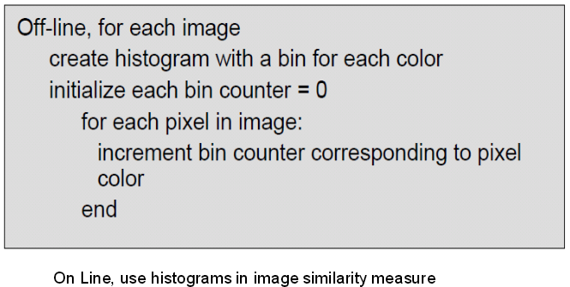
Color Histogram Extraction
4/6/2019 SS ZG537 (INFORMATION RETRIEVAL) 38
Pilani Campus

Slide 39
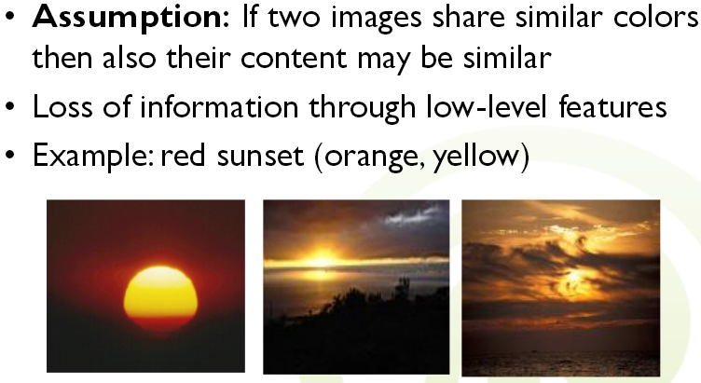
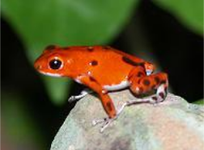
Example: Low-level Color Features
4/6/2019 SS ZG537 (INFORMATION RETRIEVAL) 39
Pilani Campus

Slide 40
Simple histogram distance measure
The distance between the histogram of the query image and images in the database are measured
Image with a histogram distance smaller than a predefined threshold are retrieved from the database
The simplest distance between images I and H is the L-1 metric distance as D(I,H) = sum |I-H|
4/6/2019 SS ZG537 (INFORMATION RETRIEVAL) 40
Pilani Campus

Slide 41
Comparison of Image
Compare images based on the color? Extract color features first –
Each pixel of an image contains color information
Images consist of many pixels
Pixel by pixel?
Aggregation for comparisons?
Average color
Color histograms
Color layout (regions)
4/6/2019 SS ZG537 (INFORMATION RETRIEVAL) 41
Pilani Campus

Slide 42

Average Color
Comparison of 2 images x and y by using the Euclidean distance for the average color
Very bad similarity measure
E.g., magenta image and red blue image are the same according to average color
X
Y
4/6/2019 SS ZG537 (INFORMATION RETRIEVAL) 42
Pilani Campus

Slide 43
Average Color
Perceptionally somewhat questionable ...
But...
Quick and easy to calculate and compare
Best to use as a filter: exclude images
Dominant color influences the average color, the opposite is not valid
E.g., search for mostly blue images: exclude all images with red, yellow or green color averages
4/6/2019 SS ZG537 (INFORMATION RETRIEVAL) 43
Pilani Campus

Slide 44
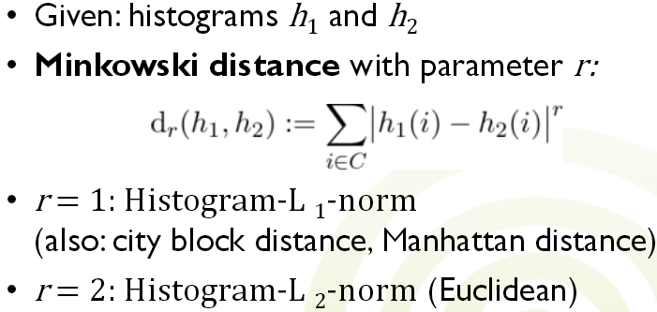
Comparison of Histograms
4/6/2019 SS ZG537 (INFORMATION RETRIEVAL) 44
Pilani Campus

Slide 45
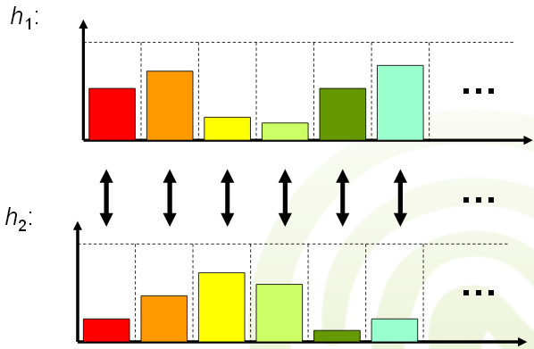
Minkowski Distance
4/6/2019 SS ZG537 (INFORMATION RETRIEVAL) 45
Pilani Campus

Slide 46
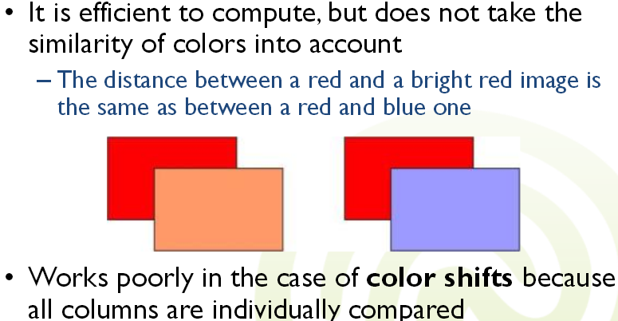
Minkowski Distance
4/6/2019 SS ZG537 (INFORMATION RETRIEVAL) 46
Pilani Campus

Slide 47
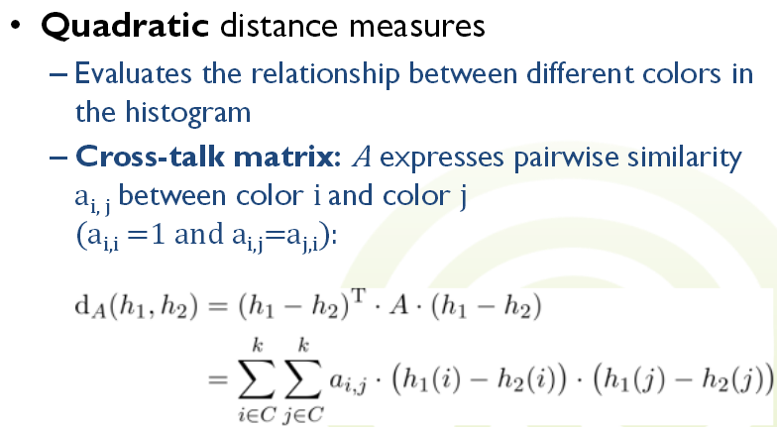
Comparison of Histograms
4/6/2019 SS ZG537 (INFORMATION RETRIEVAL) 47
Pilani Campus

Slide 48
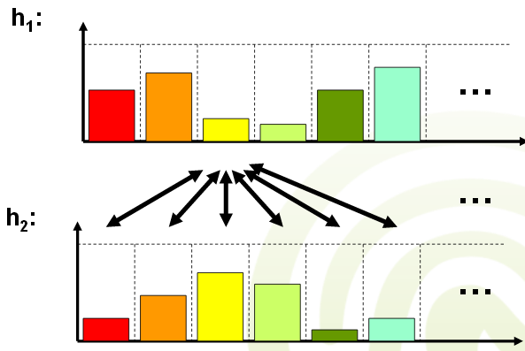
Quadratic Distance Measure
4/6/2019 SS ZG537 (INFORMATION RETRIEVAL) 48
Pilani Campus

Slide 49
Example
An image of 5x4 pixels K=0,1,2,..,L-1=255.
L=256 levels
Sketch the histogram
7 | 100 | 200 | 45
2 | 100 | 7 | 120
100 | 100 | 7 | 120
200 | 100 | 45 | 100
200 | 200 | 45 | 45
M rows
Normalized
Count
P(r_{k})=n_{k}/MN
level | count
2 | 1
7 | 3
45 | 4
100 | 6
120 | 2
200 | 4
N columns
1
Normalized histogram(plot it)
0.5
0 100 200
Grad level(0-255) rk
Histogram, color v.4e
49
Pilani Campus

Slide 50
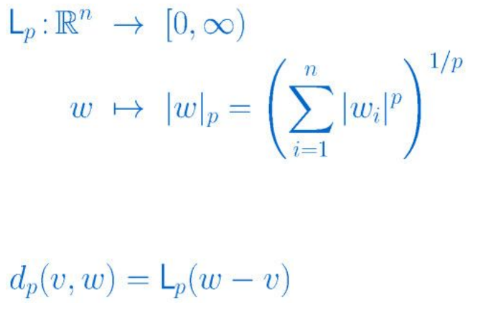
Geometric component wise: Minkowski
4/6/2019 SS ZG537 (INFORMATION RETRIEVAL) 50
Pilani Campus

Slide 51
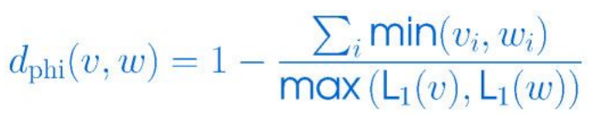
Partial histogram
The components of V and w are expected to be non-negative.
Very popular for normalized histograms
4/6/2019 SS ZG537 (INFORMATION RETRIEVAL) 51
Pilani Campus
Notes:
This measure is able to handle partial matches when the sizes of the two object vectors are different

Slide 52
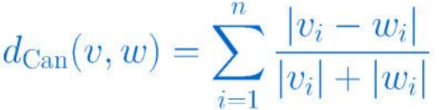
Canberra (sensitive at 0)
Geometrically motivated distance between vectors
Very sensitive for components near zero
4/6/2019 SS ZG537 (INFORMATION RETRIEVAL) 52
Pilani Campus

Slide 53
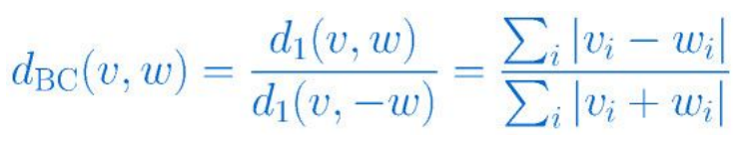
Bray Curtis dissimilarity
Derived from Manhattan distance
Approaches infinity as v approaches -w
4/6/2019 SS ZG537 (INFORMATION RETRIEVAL) 53
Pilani Campus

Slide 54
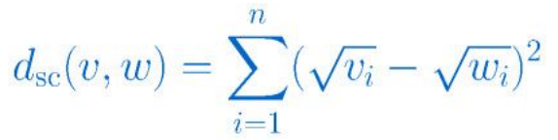
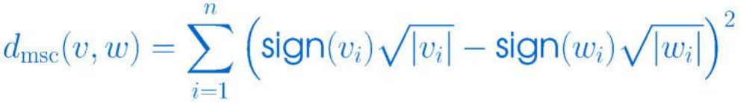
Squared chord
Used in paleontological studies in pollen data analysis and has little theoretical justification.
Connot work with negative components hence the modified version
4/6/2019 SS ZG537 (INFORMATION RETRIEVAL) 54
Pilani Campus

Slide 55
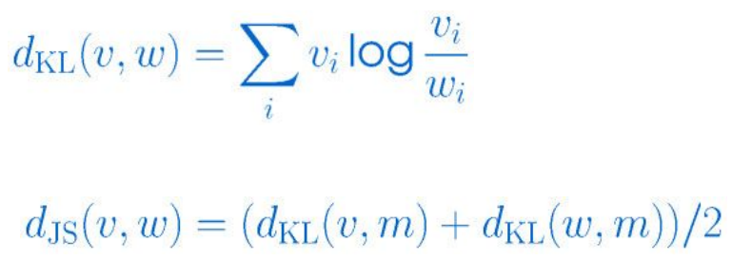
Probabilistic
Kullback-Leibler divergence express the degree of discrepancy between two probability distributions v and w.
Measure the extra information needed to express a sample from the “true” distribution v when we encode them with samples from an approximation distribution w.
For Discrete random vectors v and w, the Kullback-Leibler divergence is defined as
4/6/2019 SS ZG537 (INFORMATION RETRIEVAL) 55
Pilani Campus
Notes:
Dkl is not a distance it is not even symmetric and grows arbitrarily big for any component of w approaching to 0 which makes KL divergence unsuitable for many feature types that tend to have vanishing components.
Hence this is made symmetric through the definition of the JS divergence where m=(v+w)/2
This is finite
Both are used for probability vectors with non negative components that sum to one.
These measure are not suitable for a number of feature types for ex thoses that describe distributions with their central movements as they can be negative.

Slide 56
Feature and distance standardization
If the feature types are different then it is desirable that they must be comparable in size.
These difference can be absorbed in the distance functions that work on these features or standardize the features.
Feature or standardization has 2 objectives
Make different components of a feature vector that have different origin and meaning in comparable size
Ensure that the size of the feature vectors is bounded and hence distances between two feature vectors.
4/6/2019 SS ZG537 (INFORMATION RETRIEVAL) 56
Pilani Campus
Notes:
Standardization makes components of a feature vector comparable in range

Slide 57
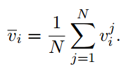
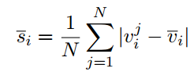
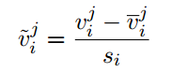
Component wise standardization using corpus statistics
Features can be standardized component wise using component mean values and their component –wise mean absolute deviation.
Both are computed per component and across the data set.
Mean absolute deviation per
component i which amounts to
Variation of the feature component i
Replace all feature vector components with
Resulting in creating feature vectors v^{~1},v^{~2}…v^{~n} ϵ R^{n}
4/6/2019 SS ZG537 (INFORMATION RETRIEVAL) 57
Pilani Campus
Notes:
Resulting in creating feature vectors v^{~1},v^{~2}…v^{~n} ϵ R^{n} whose components have a size 1 and mean of 0
This process creates feature vectors with negative components

Slide 58
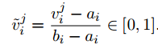
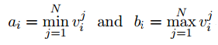
Range standardisation
If the feature components i are known to lie in the range [a_{i},b_{i}] Э v_{i}^{j} each, then the feature vectors can be transformed according to
One can determine suitable values a_{i}, b_{i} ∈ R easily through
This transformation is most useful for uniformly distributed features, but might suffer from the effects of outliers, which adversely move the minimum and maximum boundaries.
4/6/2019 SS ZG537 (INFORMATION RETRIEVAL) 58
Pilani Campus

Slide 59
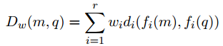
Fusion of Feature Spaces and Query Results
Single Query Example with Multiple Features
Assume that there is a single query example q and that each multimedia document m gives rise to a number of low-level features f1(m), f2(m), . . ., fk(m), each of which would typically be a vector describing some aspect such as colour, texture, shape, timbre etc
Combined Overall Distance
Most systems accumulate the distances of these features to the corresponding features of the query q in order to define an overall distance
between multimedia documents m and a query q. Here di(·, ·) is a specific distance function between the vectors from the feature i, and wi ∈ R is a weight for the importance of this feature
4/6/2019 SS ZG537 (INFORMATION RETRIEVAL) 59
Pilani Campus
Notes:
Note that the overall distance Dw(m, q) is the number that is used to rank the multimedia documents in the database, and that the ones with the smallest distance to the query are shown to the user as query result Note also that the overall distance and hence the returned results crucially depend on the weight vector w = (w1, . . . , wr). In most interfaces, the user can either set the weights explicitly as in the interface , or the system can change the weights implicitly if the user has given feedback on how well the returned documents fit their needs.

Slide 60

Fusion of Feature Spaces and Query Results
Convex Combinations or not?
In the above w_{i} are arbitatry real numbers and so is the range of distance functions d_{i}
If the weights are restricted in this way then the sum in the first equation is called a Convex Combination.
4/6/2019 SS ZG537 (INFORMATION RETRIEVAL) 60
Pilani Campus

Slide 61
Take home message
Since the features for multimedia objects are extracted using different tools it is nessary to under the underlying representation of these features.
If necessary they have to be standardized.
Efficient data structures have be used for indexing which can serious affect the performance of the system.
Sometimes it may be essential to have one or many query objects as input at the same time which has be handled using different techniques explained.
4/6/2019 SS ZG537 (INFORMATION RETRIEVAL) 61
Pilani Campus

